Slide 1
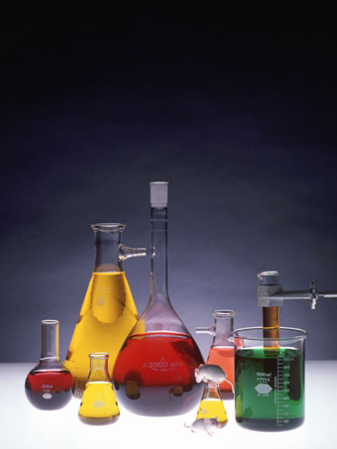

Solutions
& Solubility

Slide 2
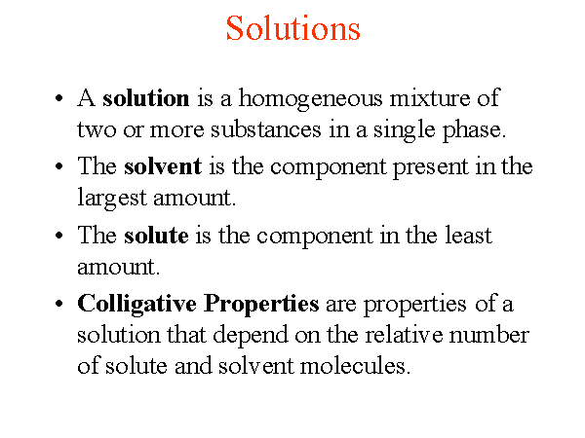

Slide 3
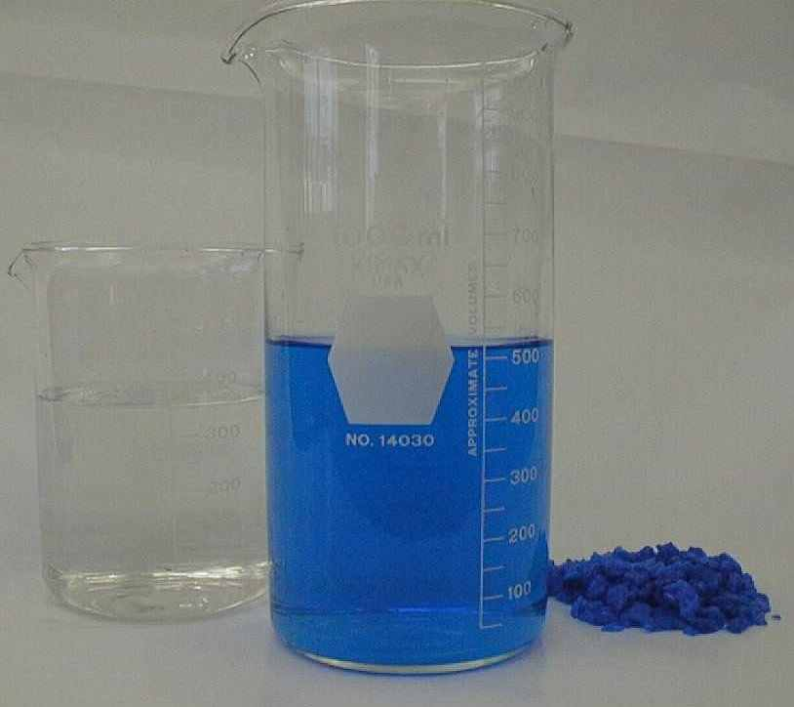
Solutions are homogeneous mixtures eg. Air, cordial, blood, brass. The material doing the dissolving is called the solvent while the material being dissolved is called the solute.
solvent
solution
solute

Slide 4
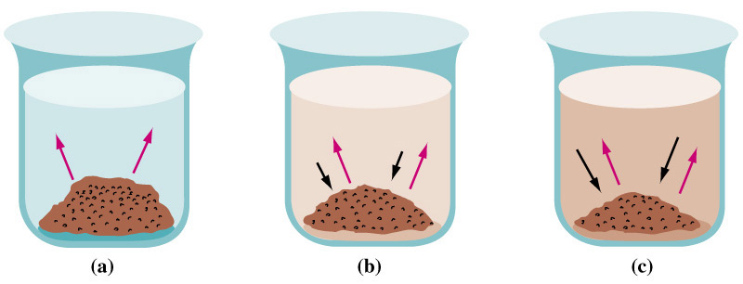
Saturated and Unsaturated Solutions
When a solute is added to a solvent it will start to dissolve.
The solution is unsaturated as it contains less than the maximum amount of solute it can hold. It continues to dissolve.
Once the solution contains the maximum amount of solute the solution is said to be saturated, at which stage the rate of dissolving( ) is equal to the rate of re-crystallisation ( ).

Slide 5
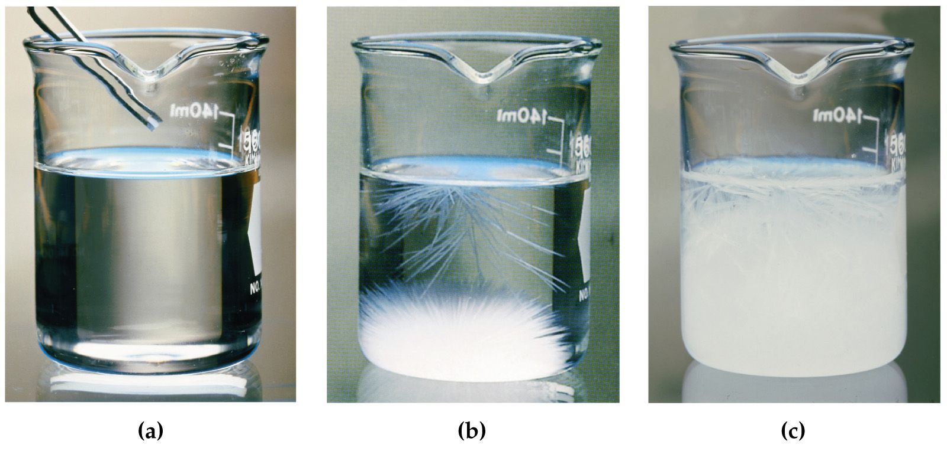
Supersaturated Solutions
The solution is said to be supersaturated if it contains more than the maximum allowable amount of dissolved solute for that temperature. This is usually achieved by dissolving the solute in a hot solvent then allowing it to cool.
Below a supersaturated solution of sodium acetate is “seeded” with a crystal to initiate crystallisation. Crystallisation continues until the solution is saturated (no longer supersaturated).

Slide 6
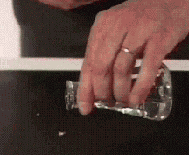
Supersaturated Solutions
Crystallisation from a supersaturated solution of sodium acetate.

Slide 7
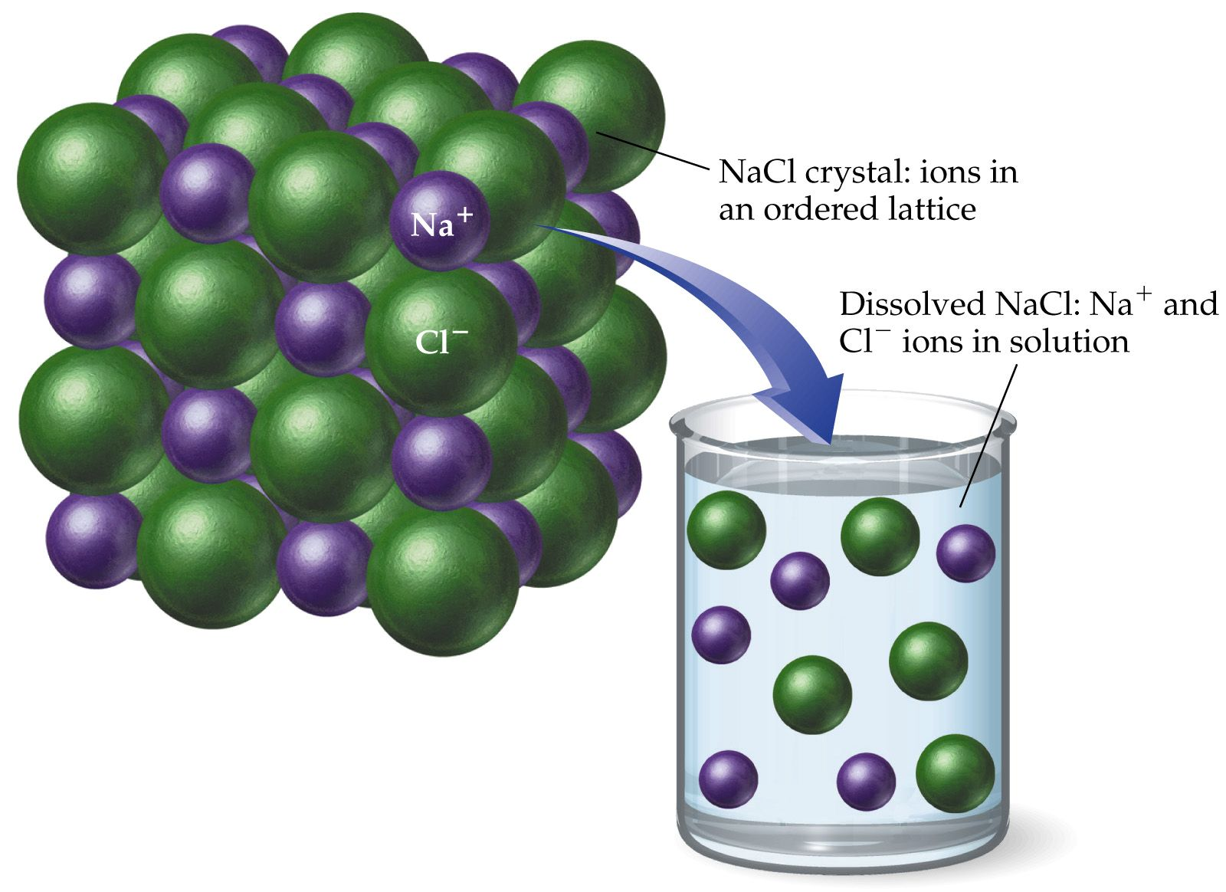
When an ionic solid dissolves it separates into its constituent ions. Eg. sodium chloride dissolving in water dissociates into Na⁺ & Cl⁻ ions. The ions are free to move hence a conducting solution (or electrolyte) is formed.
The Solution Process

Slide 8
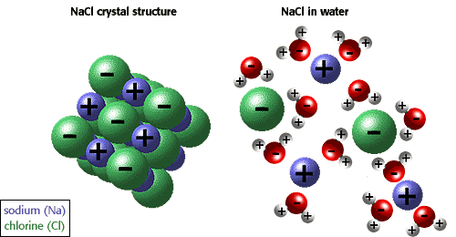
Each ion becomes surrounded by water molecules. The polar nature of water means that the water molecules arrange themselves with the positive ends of the molecule facing the negative chloride ion, while the negative end of the water molecule is attracted to the sodium ions.

Slide 9
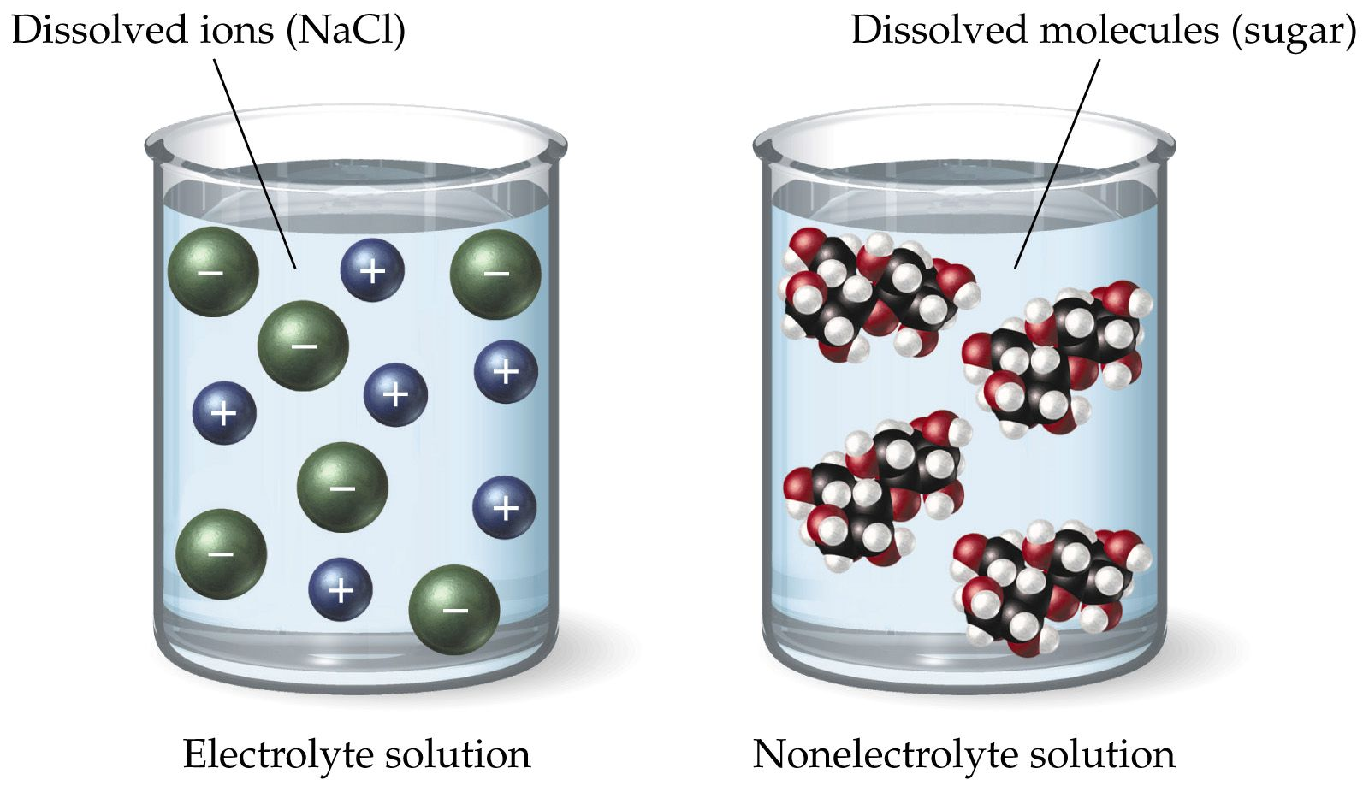
Substances which neither dissociate into ions nor form ions when placed in water (ionise) form non-electrolytes. These are solutions which do not conduct electricity. In these solutions the molecules remain whole.

Slide 10
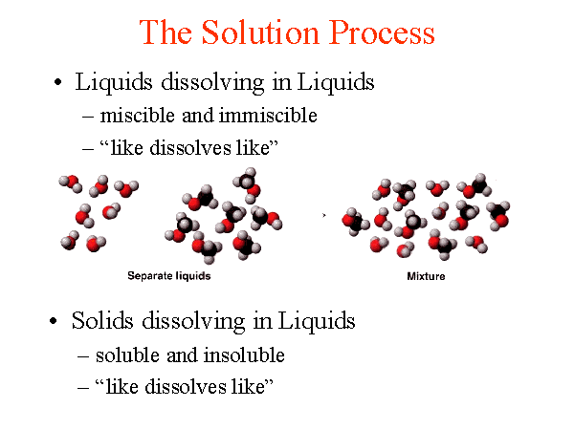

Slide 11
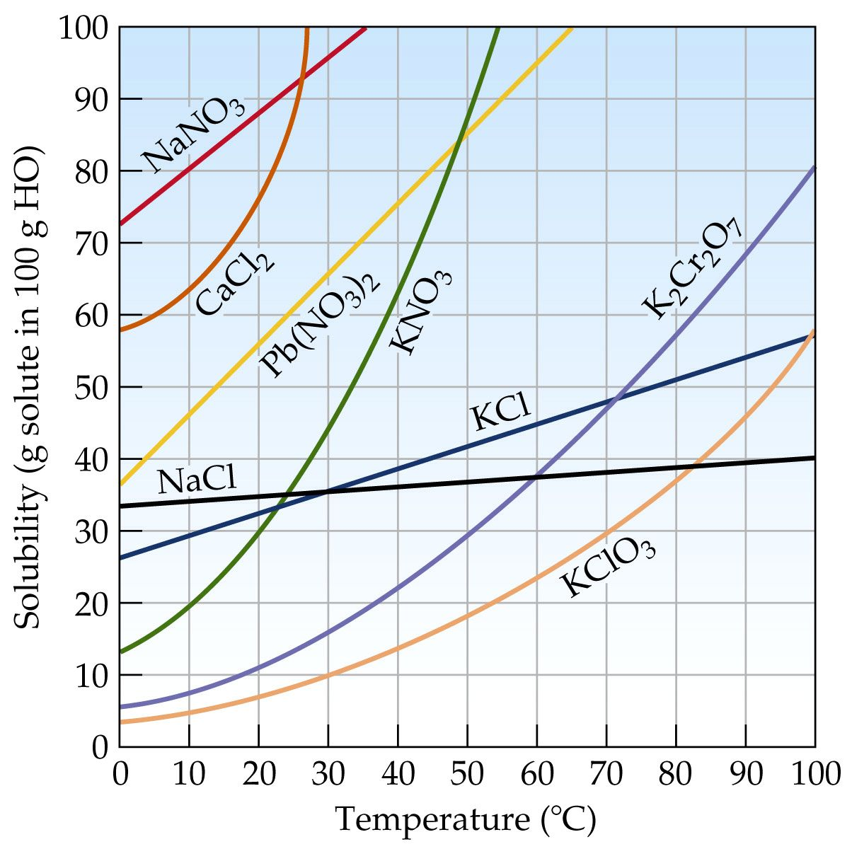
The Effect of Temperature on Solubility of Solids.
The solubility of most ionic solids in water increases with increasing temperature.

Slide 12
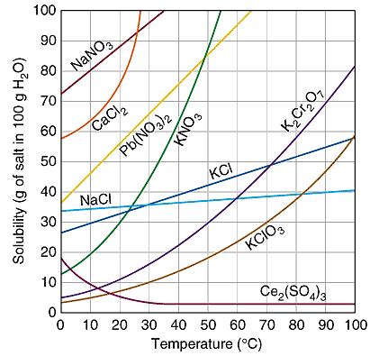
The solubility of caesium sulfate in water however, decreases with increasing temperature.

Slide 13
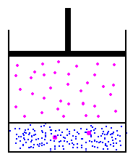
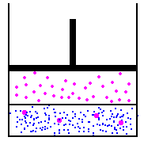
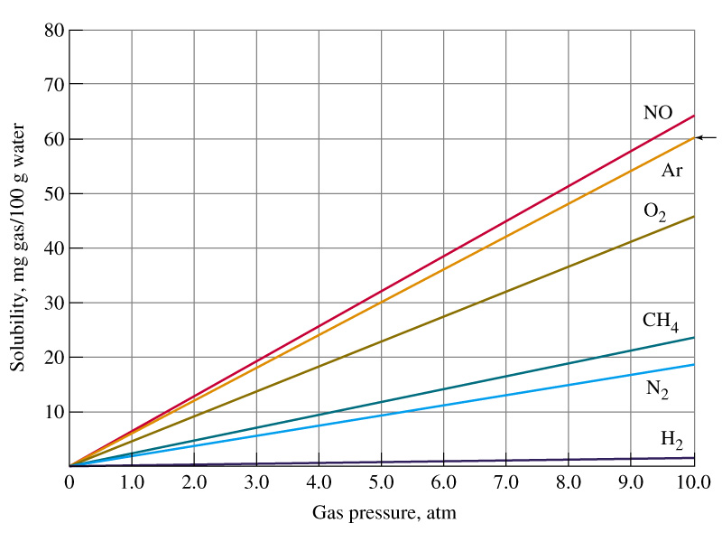
The Effect of Pressure on Gas Solubility.
Doubling the pressure doubles the solubility
Solubility of some common gases in water.

Slide 14
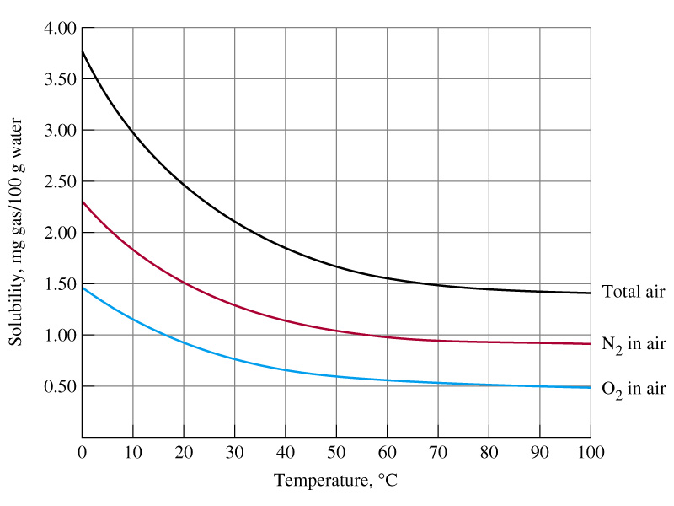
The Effect of Temperature on Gas Solubility.
Unlike liquids and solids, gases tend to become less soluble in water as the temperature increases.

Slide 15
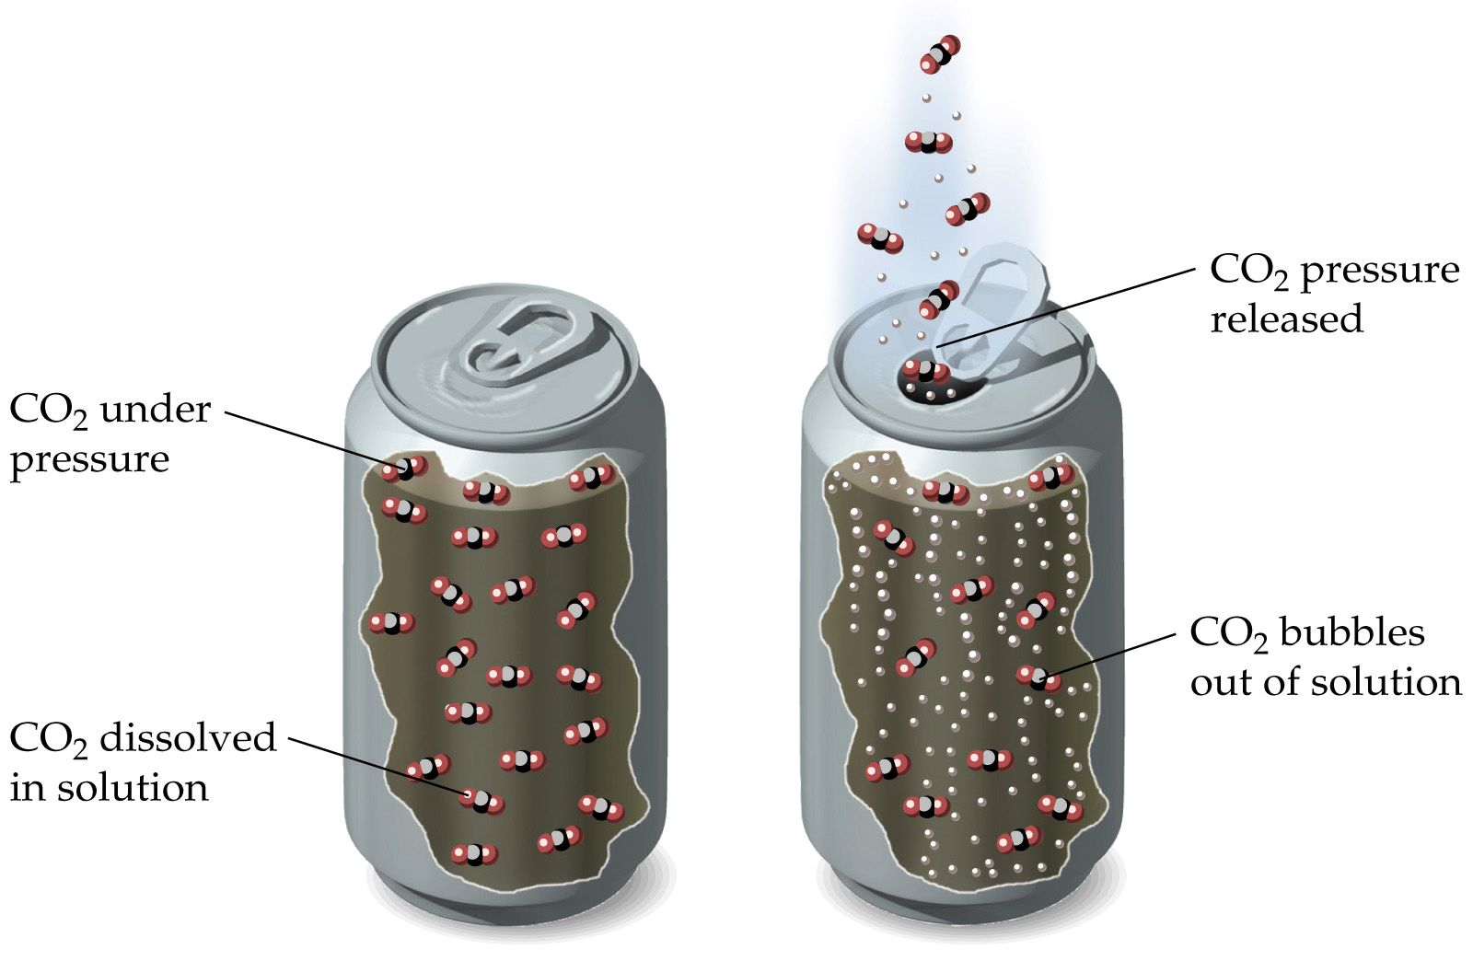
Question. What conditions should carbonated drinks be stored in to keep them from going ‘flat’?

Slide 16
Question. What conditions should carbonated drinks be stored in to keep them from going ‘flat’?
Answer. Cold & keep the lid on to keep pressure of CO₂ high.

Slide 17
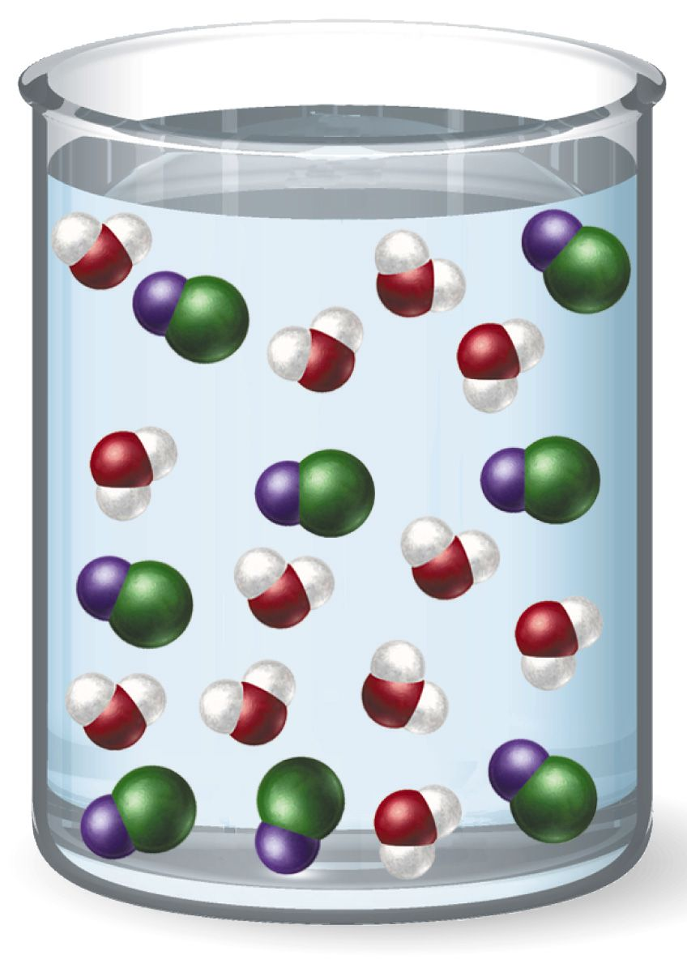
Question. What’s wrong with this diagram depicting a solution of sodium chloride, NaCl ?

Slide 18
Question. What’s wrong with this diagram depicting a solution of sodium chloride, NaCl ?
Answer. NaCl does not form molecules - it would dissociate into Na⁺ and Cl⁻ ions.

